Slide 1
Automated Detection and Classification of Leaf Diseases in Black Gram Using Deep Learning Techniques
Nurjahan Akther Mim
ID : 221-15-4782
Department of CSE
Daffodil International University
Mr. Mayen Uddin Mojumdar
Sr. Lecturer
Department Of CSE
Daffodil International University

Slide 2
Outline
Introduction
Problem Statement
Motivation and Objective
Related Works
Comparison Between Existing Works
Gap Analysis
Proposed Methodology
Q & A

Slide 3
Introduction
Black gram is an important pulse crop in South Asia, including Bangladesh, valued for its nutritional benefits, soil fertility improvement, and economic importance. However, diseases like Yellow Mosaic Virus (YMV), Cercospora Leaf Spot, Leaf Crinkle, Anthracnose, and Powdery Mildew significantly reduce yield and quality.
Traditional detection methods rely on farmers or experts visually inspecting leaves, which is slow, subjective, and often inaccurate in real farming conditions.
Recent research shows that Deep Learning, especially Convolutional Neural Networks (CNNs), can detect plant diseases from images with high accuracy. However, many existing models are large, require high computing power, and are not suitable for rural areas with limited internet and hardware resources.
This research develops a lightweight CNN model for detecting five types of black gram leaf diseases using a custom, expert-labeled dataset collected from fields in Bangladesh. The dataset was preprocessed using resizing, CLAHE contrast enhancement, and normalization, and balanced through data augmentation.
The final optimized model is deployed in a TensorFlow Lite + Flutter mobile application, enabling offline, real-time diagnosis in the field. This work enhances disease detection accessibility, improves model efficiency, and supports sustainable agriculture by enabling early detection and timely crop management.

Slide 4
Problem Statement
High Crop Losses – Black gram yield and quality are heavily affected by diseases such as Yellow Mosaic Virus (YMV), Cercospora Leaf Spot, Leaf Crinkle, Anthracnose, and Powdery Mildew.
Limitations of Manual Inspection – Current detection methods depend on farmers or experts visually checking leaves, which is slow, subjective, and often inaccurate in real farming conditions with varying lighting and complex backgrounds.
Lack of Lightweight AI Solutions – Many deep learning approaches for plant disease detection are computationally heavy, require high-end hardware, and are not suitable for rural farming areas with limited resources.
Limited Multi-Disease Field Performance – Few existing systems can accurately detect and classify multiple black gram diseases from field-captured images with high accuracy.
Dataset Imbalance – The collected dataset showed uneven class distribution, which can bias model learning and reduce generalization.
Deployment Limitations – Many current solutions are not optimized for offline, mobile-based use, preventing instant diagnosis in areas without stable internet.

Slide 5
Motivation and Objective
Motivation | Objective
Black gram is a vital crop in Bangladesh, important for nutrition, soil fertility, and rural livelihoods. Leaf diseases like YMV, Cercospora Leaf Spot, Leaf Crinkle, Anthracnose, and Powdery Mildew cause major yield loss. Traditional visual detection is slow, subjective, and often inaccurate in real farming conditions. Deep Learning (CNNs) can detect diseases from images, but existing models are too large and resource-heavy. A lightweight, offline-capable mobile solution can provide farmers with instant, accurate diagnosis in the field. | Develop a lightweight CNN model to detect and classify five black gram leaf diseases. Preprocess images using resizing, CLAHE contrast enhancement, and normalization. Balance dataset classes through Keras-based augmentation techniques. Evaluate multiple CNN architectures to select the most efficient and accurate model. Deploy the final model via TensorFlow Lite in a Flutter mobile app for offline, real-time use.

Slide 6
Related Works
Hajare & Rajawat (2025) – Developed a deep ensemble model (DBN, RNN, CNN) optimized with SIDMO for black gram disease classification; limited by high computational cost.
Jyothi & Prasad (2025) – Proposed VGGNet with CLAHE preprocessing and Watershed segmentation for Cuscuta detection; risk of overfitting due to reliance on segmented images.
Talasila et al. (2025) – Used DeepLabv3+ (ResNet-18) for segmentation and EfficientNet-B0 for classification; performance sensitive to noisy field backgrounds.
Sangar & Rajasekar (2025) – Introduced a wavelet-transformed AttentionNet with SVM; requires complex preprocessing steps.
Sharma & Kumar (2024) – Designed a hybrid CNN–Transformer model; high model complexity increases overfitting risk on small datasets.
Mallick et al. (2023) – Created a smartphone-based DL model for mung bean disease detection; crop-specific limitations affect generalization to black gram.

Slide 7
Comparison Between Existing Works
Author & Year | Method / Approach | Accuracy | Contribution
Hajare & Rajawat (2025) | Deep ensemble (DBN, RNN, CNN) + SIDMO | 94.82% | Combined multiple DL architectures with metaheuristic optimization for black gram disease detection.
Jyothi & Prasad (2025) | VGGNet + CLAHE + Watershed segmentation | 99.78% | Developed preprocessing-based approach for accurate Cuscuta detection in black gram leaves.
Talasila et al. (2025) | DeepLabv3+ (ResNet-18) + EfficientNet-B0 | 99.72% | Integrated segmentation and classification models for improved disease detection in field conditions.
Sangar & Rajasekar (2025) | Wavelet-transformed AttentionNet + SVM | 99.50% | Used wavelet-based augmentation and attention mechanisms for enhanced feature extraction.
Sharma & Kumar (2024) | Hybrid CNN–Transformer | 99.56% | Combined CNN with Transformer architecture for robust multi-disease classification.
Mallick et al. (2023) | Smartphone-based DL model (Mung Bean) | 93.65% | Demonstrated mobile-based deep learning application for disease and pest detection.

Slide 8
Gap Analysis
Models achieve high accuracy in lab datasets but fail in real-field conditions.
Small and unbalanced datasets limit generalization.
Complex hybrid models not suitable for mobile or low-resource devices.
Lack of early-stage disease and severity level detection.
Segmentation methods struggle with low contrast or overlapping leaves.
Augmentation cannot replicate true environmental diversity.
No large-scale, multi-location field validation.
Minimal integration with real-time farmer feedback or IoT systems.

Slide 9
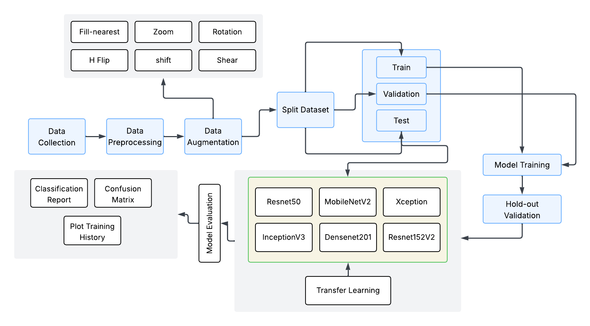
Proposed Methodology

Slide 10
THANK YOU

